Slide 1

Human Subjects Research
Ethics and Informed Consent in Practice and Protocol
&
Human Subjects Research Project Management
Rowan Institutional Review Board
Office of Research Compliance, Division of University Research
February 24, 2025
Speaker & Presenter: Eric Gregory
Consultant & Contributor: Dr. Joanna Petrides

Slide 2

Research Ethics
Rowan Institutional Review Board
Office of Research Compliance, Division of University Research
Stem from unethical research in biomedical sciences throughout the World, including in the United States
U.S. government created the National Commission for the Protection of Human Subjects of Biomedical and Behavioral Research (the Commission)
  The Commission issued the Belmont Report in 1979, the foundational document for U.S. human subjects protections
The Belmont Report
Respect for Persons
  Individuals treated as autonomous agents
  Individuals with diminished autonomy are entitled to protection
Beneficence
  Obligation to respect individuals' decisions
  Obligation to protect individuals from harm
  Obligation to secure individuals’ well-being
Justice
  Benefits and burdens distributed equitably so that no one individual or population is exposed to risks/harms and another population receives the benefits

Slide 3

Research Ethics In Practice
Rowan Institutional Review Board
Office of Research Compliance, Division of University Research
Respect for Persons
  Informed Consent
    Obtain and document subjects’ voluntary participation when acquiring research data that is identifiable
    Inform subjects’ when information about them or provided by them is being used for research purposes
    Researchers identify themselves as researchers and communicate purpose of interacting with subjects
    Consider impact of combining datasets, even if not identifiable data is included, to the extent when combined can re-identify subjects
  Privacy
    Interact and converse with potential subjects in a private setting at an appropriate time
    Restrict access to subjects’ identifiable information, when possible
    Replace any identifiable information with unique identifier or code

Slide 4
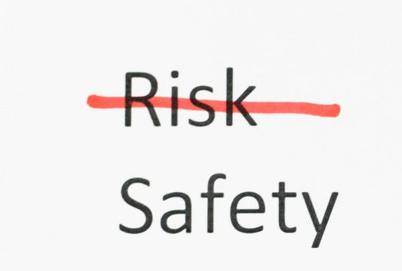
Research Ethics In Practice
Rowan Institutional Review Board
Office of Research Compliance, Division of University Research
Beneficence
  Assessment of Risks and Benefits
    Systematic and comprehensive
    Identify the risks – known, unknown, and because of participation
    Identify the magnitude and likelihood of risks
    Identify the benefits – individual, group of people, indirect, or societal
    Identify direct benefit(s) or no direct benefit(s) to subjects and benefits to population/society
  Minimize Risk
    To the extent allowable
    Evaluate the risks and develop protocols and procedures that minimize, mitigate, or eliminate risk
    Implement study procedures to ensure benefits are gained and subjects’ rights are not affected
    Implement alternate methods, mitigating risks, to accomplish goals/aims of research
Justice
  Subject Selection
    Select subject population(s) based on the goals/aims/hypothesis of the study/research
    Consider if additional populations can benefit and incorporate them into subject inclusion criteria
    Avoid convenience sampling, and if not possible, provide justification for convenience sampling
    Identify subject population(s) who will benefit and incorporate them into subject inclusion criteria
    Avoid selecting subject population(s) in a compromised position or are easily manipulated

Slide 5
Incorporating Research Ethics in the Protocol
Rowan Institutional Review Board
Office of Research Compliance, Division of University Research
Respect for Persons
Informed Consent
  Signed Consent vs. Alteration of Consent vs. Waiver of Consent
  Justify why waiver of consent is necessary
Privacy
  Detail data handling and management methods and processes that ensures confidentiality and privacy
  Detail recruitment and consent methods and processes to ensure voluntary participation and privacy
  Statement of how research data will be accessed, shared, managed, and reported
Beneficence
Assessment of Risks and Benefits
  Comprehensive and analytical
  Justification of risks if no direct benefit to subjects is present
Minimize Risk
  Include alternate procedures and methods to either reduce, mitigate, or eliminate risk
Justice
Subject Selection
  Detail subject populations, including demographics and characteristics
  Justify why subject groups are included
  Provide statement why women, children, or other subject populations are not selected, if research could be beneficial to that segment of the population

Slide 6

Informed Consent
Rowan Institutional Review Board
Office of Research Compliance, Division of University Research

Slide 7
Basic Elements of Consent (CFR 46.116(b)(1) to 46.116(b)(9)
Rowan Institutional Review Board
Office of Research Compliance, Division of University Research
Informed Consent Elements
Statement that study involves research and purpose of the research
Expected duration of the subject’s participation
Description of procedures to be followed and identification of experimental procedures
Description of foreseeable risks to the subject and any benefits to the subjects or others
Disclosure of appropriate alternative procedures or courses of treatment, if any, that might be advantageous to the subject
Description of how confidentiality of records that identify the subject will be maintained
Research involving more than minimal risk must include the following:
  Explanation whether any medical treatments are available if injury occurs
  If treatments are available then describe:
    What they are
    What compensation is provided
    Where more information may be obtained
Whom to contact for answers about the research and subjects’ rights
Whom to contact in the event of a research-related injury
Statement that participation is voluntary, refusal to participate or discontinuing participation will involve no penalty or loss of benefits to which the subject is otherwise entitled to
Statement whether identifiable information or biospecimens will be de-identified and used for future purposes or will not be used for future purposes

Slide 8

Informed Consent In Practice
Rowan Institutional Review Board
Office of Research Compliance, Division of University Research
Informed Consent
  Have discourse and discussion with potential subjects
  Read through entire consent form with potential subjects
  Answer all questions potential subjects may have
  Give time to potential subjects to volunteer
  Avoid settings and times that may lead to coercion or undue influence
  If information about the study cannot be shared prior to or during subject participation, then develop and implement procedures so that prior to final use and retention of data, subjects are made aware of additional information about the research/study
Consent when Research is Exempt
  Obtain oral or electronic voluntary participation, when necessary and applicable
  When required by law, obtain and document consent – for example, minors and access to educational records
  Incorporate privacy and confidentiality plans/procedures of research data
Broad Consent
  Notify and communicate use of broad consent to IRB
  Include broad consent elements, as necessary (45 CR 46.116(d))
Waiver of Consent
  Only applicable when research involves no more than minimal risk
  Waiver does not adversely affect subjects’ rights
  When appropriate Legal Authorized Representative or Subjects receives pertinent information after participation

Slide 9


Incorporating Informed Consent In the Protocol
Rowan Institutional Review Board
Office of Research Compliance, Division of University Research
Informed Consent
  Identify when and where consent will take place
  Detail process of consent, including recruitment
  Clearly state and detail process when recruiting vulnerable populations
  Include all elements of consent and additional elements of consent, as necessary
  Write informed consent document in 8th/9th grade level
  Avoid use of grant/award language and complex, scientific language in informed consent document
  If deception is being employed, detail the process of when subjects will be informed of deception and attach subject debriefing notification and consent
Consent when Research is Exempt
  Justify why informed consent is not required
  Include applicable elements of consent when obtaining oral or electronic consent
  Detail signed consent procedures, when applicable
Broad Consent
  Justify why broad consent is required
Waiver of Consent
  Include statement why waiver of consent is necessary
  Justify how waiver of consent meets the requirements and does not adversely affect subjects' rights
  Detail process how subjects or Legal Authorized Representatives will be contacted after participation

Slide 10

Rowan Institutional Review Board
Office of Research Compliance, Division of University Research
Human Subjects Research Project and Protocol Development

Slide 11


Human Subjects Research Project and Protocol Development
Rowan Institutional Review Board
Office of Research Compliance, Division of University Research
Planning - Phases 1 and 2
Planning – Phase 1
  Identify issue, problem, or topic of interest/study
  Conduct literature review on topic
  Identify background and purpose
  Identify initial objective(s) and investigation plan(s)
Planning – Phase 2
  Identify key personnel and resources
  Identify primary(s) procedures and data collection points
  Identify subject population
  Create initial recruitment strategy
  Identify subject risks
  Identify identifiable data needed
  Create initial data management plan
  Review federal regulations to determine what type of review is required
    Exempt, Expedited, or Full Board

Slide 12
Human Subjects Research Project and Protocol Development
Rowan Institutional Review Board
Office of Research Compliance, Division of University Research
Planning - Phase 3
Planning – Phase 3
  Secure any collaborator(s) and/or non-Rowan entity support (if applicable)
  Confirm location/site access, research team members commitment, and funding
  Initiate any Rowan ancillary committee approvals – IBC, COIC
  Create final draft of investigation plan and research design
    Includes screening, treatment and follow-up, end of study visit procedures
    Control vs. experimental group(s)
  Determine final study population(s)
    Includes demographics, targeted populations, inclusion and exclusion criteria
    If study population has a convenience factor, justify convenience sample population

Slide 13


Human Subjects Research Project and Protocol Development
Rowan Institutional Review Board
Office of Research Compliance, Division of University Research
Planning - Phase 3
Planning – Phase 3
  Create final recruitment strategy(ies)
    Includes method of recruitment and subject population characteristics considerations
    Pre-screening consent
    Signed, alternate (oral or electronic/digital), or waiver of consent
  Create final study procedures
    Includes screening procedures, treatment(s), information on mediation, and withdraw and early termination
    Control and experimental group(s) administration – randomization, blinding
  Draft final management data plan
    Includes data security, transfer, storage, sharing, future research use, and destruction/retention

Slide 14
Human Subjects Research Project and Protocol Development
Rowan Institutional Review Board
Office of Research Compliance, Division of University Research
Planning – Phase 4
Planning – Phase 4
  Communicate all required training and approvals to research team members
    Includes CITI & HIPAA trainings (General HIPAA and HIPAA for Research)
  Finalize evaluation measures
    Includes information and test(s) conducted for arm(s)/goal(s), screening and baseline measurements, and/or information from existing data or medical charts
  Finalize statistical analysis procedures
    Includes endpoint(s), pharmacokinetic and subject safety analysis, and sample size
  Complete statement on regulatory and ethical considerations
    How is the study designed to address informed consent, privacy, minimization of risk, equity in subject population(s), subjects requiring additional protections, and protection of subjects’ rights and safety/well-being?
  Finalize systematic risk – benefit assessment
    Includes all possible risks, likelihood of risks, and specific research-related risks
    Includes risks related to physical, psychological, emotional, loss of confidentiality, legal/civil, financial/employment, and social
    Includes any possible adverse reactions to known, possible risks
    Includes direct benefits or statement of no direct benefit
    Includes indirect benefits

Slide 15
Human Subjects Research Project and Protocol Development
Rowan Institutional Review Board
Office of Research Compliance, Division of University Research
Planning – Phase 5
Planning – Phase 5
  Finalize informed consent procedures
    Identify research team member(s) interacting with subjects
      NOTE: Only individuals listed as investigators/co-investigators/other research staff can recruit participants
    Sites/locations of informed consent (interaction with subjects)
    Includes applicable informed consent elements (45 CFR 46.116(b), 46.116(c) and 46.116(d))
    Includes HIPAA authorization, Legal Authorized Representative (LAR), Assent (Minors), and/or FERPA authorization
    Includes costs and payment(s) to subject
  Finalize study protocol document/template
  Finalize recruitment instruments, study instruments, data collection instruments, debriefing memos, study brochures, data management plan(s), etc.
  Acquire all non-Rowan entity support letters, training certificates, and FDA approvals/registrations
  Begin sponsor reporting requirements
    Includes clinicaltrials.gov
  IMPORTANT: Final PI review and approval of all and any changes/revisions made to study procedures and research instruments/documents
  Create study in Rowan Cayuse Human Ethics/IRB; complete and submit IRB submission

Slide 16

Rowan Institutional Review Board
Office of Research Compliance, Division of University Research
Human Subjects Research Project and Protocol Development

Slide 17
Human Subjects Research Project and Protocol Development
Rowan Institutional Review Board
Office of Research Compliance, Division of University Research
Implementation - Phase 1
Implementation – Phase 1
  Conduct research based on IRB approved protocol, instruments, and documents
  Incorporate any other requirements related to Rowan ancillary committees or departments
    Conflict of Interest Committee management action plans
    Institutional Biosafety Committee approved procedures related to biohazards
    Data Use Agreement requirements
  Research team site/location leaders review informed consent procedure(s) and form(s) with research staff
    Includes providing research staff IRB approved protocol
    Includes review of procedures related to recruitment and pre-screening, use of study instruments, collection, transfer, and storing of research data and information, and discussion of subjects' risks and safety/well-being
  Conduct recruitment, pre-screening, and informed consent
  Enroll and oversee/perform subject-related tasks
  Collect and retain research information and data

Slide 18

Human Subjects Research Project and Protocol Development
Rowan Institutional Review Board
Office of Research Compliance, Division of University Research
Implementation - Phase 2
Implementation – Phase 2
  Perform end of study visit and any long-term follow up required
  Manage all subjects through the study procedures
  Monitor subjects' safety throughout the duration of subjects' participation
  Project and record subject population target numbers – screening and enrollment
  Periodic, interval communication about subject recruitment and enrollment to PI
    Includes subjects in-process, completed, in long-term follow-up, or withdrew/terminated
    Any issues and concerns with existing study protocol procedures
    Issues and concerns related to subject safety/well-being, including privacy and confidentiality

Slide 19
Human Subjects Research Project and Protocol Development
Rowan Institutional Review Board
Office of Research Compliance, Division of University Research
Implementation Phase 3
Implementation – Phase 3
  De-identification of research data for analysis and reporting (if necessary)
  Continuous PI or Co-Investigator monitoring
    Includes review of any protocol deviations, adverse events, or unanticipated and/or unassociated adverse events, data safety monitoring boards meeting results, reporting incidents to Rowan IRB and/or sponsor
    Includes collaborator(s) and non-Rowan entity support performance
    Includes monitoring and communicating training needs and expirations of any current, approved training or certificates
  Communicating adverse events to data safety monitoring boards
  Any changes to study protocol and procedures are evaluated
    Note: Prior to implementing any revised study procedures/protocol, need to submit a Modification to Rowan IRB for review and approval
    Includes effects to current subject populations already participating, subject populations yet to be enrolled, privacy, confidentiality, regulatory considerations, risk-benefit assessment, data management plan, resource allocation, non-Rowan entity support, ancillary committee or additional approvals, Rowan and sponsor policies and procedures, sponsor award/contract terms
  IMPORTANT: PI review and approval of any changes prior to submitting to Rowan IRB for review and approval

Slide 20


Rowan Institutional Review Board
Office of Research Compliance, Division of University Research
Human Subjects Research Project and Protocol Development

Slide 21
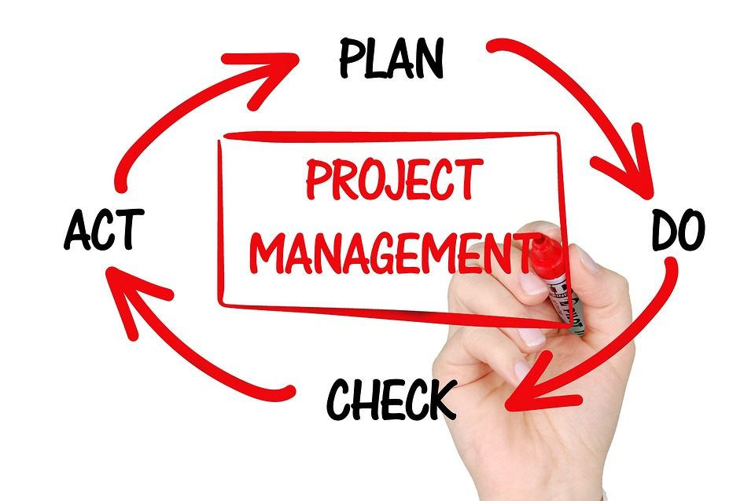
Human Subjects Research Project and Protocol Development
Rowan Institutional Review Board
Office of Research Compliance, Division of University Research
Analysis and Reporting Phase 1 & 2
Analysis and Reporting – Phase 1
  Research team site/location leaders review data analysis procedure(s)
    Includes review of IRB approved data management plan
    Includes review of data security and sharing procedures
    Includes review of data access and destruction/retention
  Acquire research data via data management plan
  Conduct analysis via IRB approved statistical analysis methods
  Evaluate research outcomes and results
Analysis and Reporting – Phase 2
  Identify significant contributors and authors
  Identify any sponsor requirements
    Includes NIH Open Public Policy, clinicaltrial.gov
  Identify any ancillary committee requirements
    Includes Rowan Conflict of Interest (COI) management action plans
  Create initial drafts of posters, presentations, and articles/sponsor reports
  IMPORTANT: PI reviews and approves all outgoing reporting of research data and/or results
    Includes posters, reports, articles, sponsor specific reports, and any reports, results, or research data shared with Rowan internal departments, units, and stakeholders
  Close IRB study if approved under IRB Expedited or Full Board review

Slide 22
Common Pitfalls in IRB Submission Process
Rowan Institutional Review Board
Office of Research Compliance, Division of University Research
Inconsistent information in research documentation, instruments, and submission sections
Research documentation, instruments, and submission sections are not written at an 8th/9th grade level
Lack of including pictures, diagrams, or detailed descriptions of instruments, devices, or biologics
Lack of obtaining Rowan ancillary committee approvals – IBC, COIC, etc.
Lack of including Rowan internal policies and procedures – ClinCard use, HIPAA training, etc.
Lack of providing protocol and informed consent documents
Lack of providing details related to interactions, interventions, and manipulations of subjects’ environment
Lack of subject interaction(s) and procedure(s) timelines
Not addressing IRB review comments timely
Lack of justifications – for example, waiver of consent, subject population(s)
Inadequate or incomplete risk and benefit analysis
Lack of detailed data management, handling, and retention procedures and description
Using grant/contract or scientific language/text in an IRB submission, including protocol

Slide 23
Rowan Institutional Review Board
Office of Research Compliance, Division of University Research
Thanks to Dr. Joanna Petrides and Rowan-VirtuaSOM Dean’s Office for supporting this presentation
AND
for attending today’s presentation!
Thank you

