Slide 1
Organizational Skills and Study Habits

Slide 2
Why is it important to be organized?
Being organized is important for academic success and helps practice self-care and preserve your well-being
Keeping track of deadlines, due dates, and exams is important to keep track of time
Being organized is particularly important since it helps learn how to prioritize activities, set and achieve goals and reduce stress
Having good organizational skills also makes it easier to collaborate with others and helps increase productivity and efficiency

Slide 3
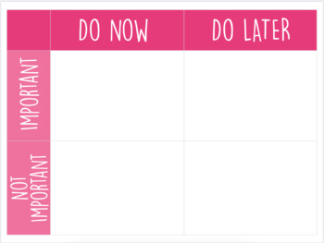
How do I know what assignments to start with?!
Feeling overwhelmed with so many assignments, projects, and exams for different classes coming up?
Try prioritizing your assignments and completing those due soonest first
Try to complete assignments ahead of time and complete them in smaller chunks rather than completing the whole task the day before it’s due
Use a checklist and check off tasks when completed

Slide 4
Study Habits
Take time to learn how you study best
Alone vs. study groups
Writing or typing notes
Review class notes and content the same day
Ask questions that you may have
Use active recall strategies to make sure you’re learning
Reach out for help
Classmates, upperclassmen, tutoring services

Slide 5
Organizational Skills
Use a calendar (try Google Calendar or Outlook Calendar so it’s accessible from your email account)
Use a planner
Use a to do list
Find a study buddy in your class to keep each other accountable and update each other on assignment progress

